Slide 1
7th Grade Ciphering

Slide 2
Sample
Solve for x:
7x + 3 = -11

Slide 4
Sample Answer
-2

Slide 6
1-1
Simplify.
$x$ $+$ (10 – 4)²$+$ 6(10$x$ + 5)

Slide 8
1-1 Answer
$$61x+66$$

Slide 9
1-2
Lathan drove for 75 miles. The trip took him 3 hours. Find Lathan’s rate of speed.

Slide 11
1-2 Answer
15

Slide 12
1-3
What number is in the hundredths place in
$\frac{385}{500}$

Slide 14
1-3 Answer
7

Slide 15
1-4
$$12x$$
$$3x+45$$
$12x$ and 3$x +45 are vertical angels.$
$$Find the value of x.$$

Slide 17
1-4 Answer
$$x=5$$

Slide 18
1-5
Simplify the expression:
$$3\left(6a−4b\right)+10b −3(7a+3)$$

Slide 20
1-5 Answer
$$−3a −2b −9$$

Slide 21
Extra 1
Forty more than three times a number is at least a hundred. Find the least number that meets this condition.

Slide 23
Extra Answer
30

Slide 25
2-1
Find the mode and median of the following numbers:
69, 96, 49, 81, 69, 16, 50, 51, 69, and 96

Slide 27
2-1 Answer
69 and 69

Slide 28
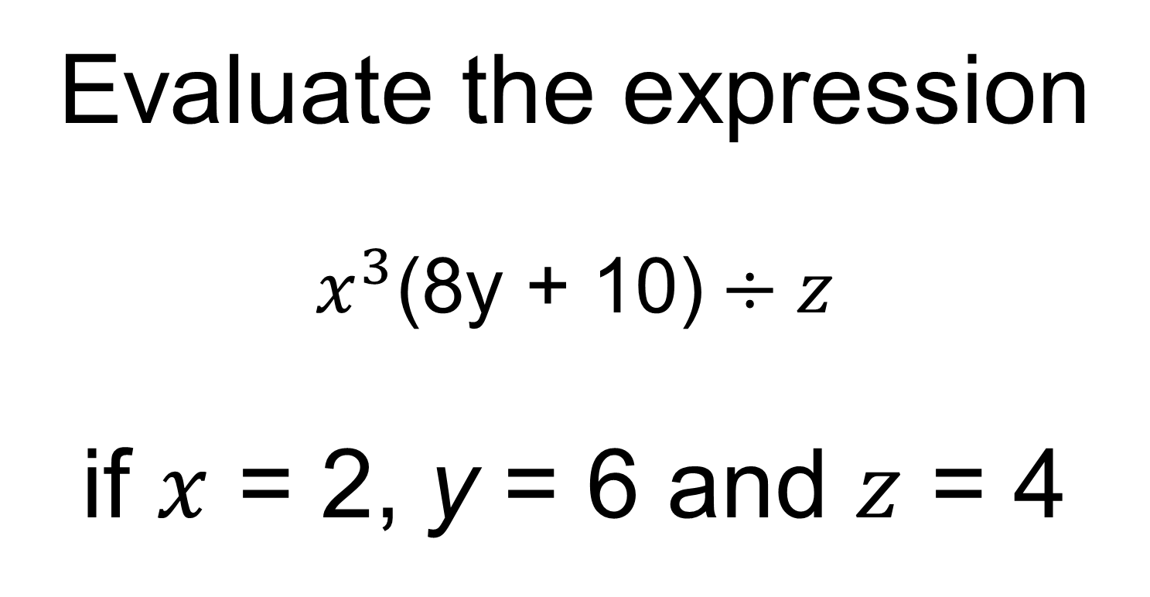
2-2
Evaluate the expression
$$x^{3}\text{(8}\text{y}\text{ + 10)}÷z$$
if $x$ = 2, y = 6 and $z$ = 4

Slide 30
2-2 Answer
116

Slide 31
2-3
A homeowner whose house is assessed for $200,000 pays $2,000 in taxes. At the same rate, what is the tax on a house assessed at $240,000?

Slide 33
2-3 Answer
$2,400

Slide 34
2-4
Tommy has practiced playing the trumpet 6 out of the last 8 days. What percent is this?

Slide 36
2-4 Answer
75%

Slide 37
2-5
Write an equation in slope-intercept form for the line that passes through the points (-2,4) and (1,2).

Slide 39
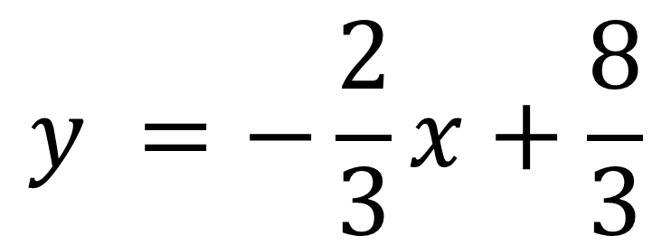
2-5 Answer
$$y =−\frac{2}{3}x+\frac{8}{3}$$

Slide 40
Extra 2
Write the decimal as a mixed number in simplest form.
4.875

Slide 42
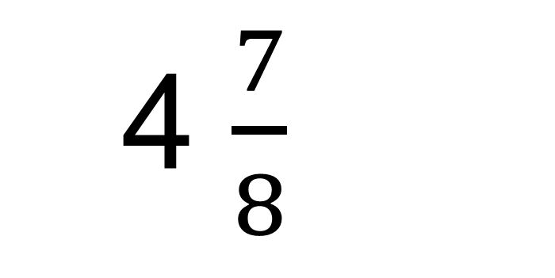
Extra 2 Answer
4 $\frac{7}{8}$

Slide 43
3rd Cipherer

Slide 44
3-1
Evaluate
$${\left(25−2\right)}^{0}÷\left[2\left(−3\right)2\right]∙3$$

Slide 46
3-1 Answer
0.168

Slide 47
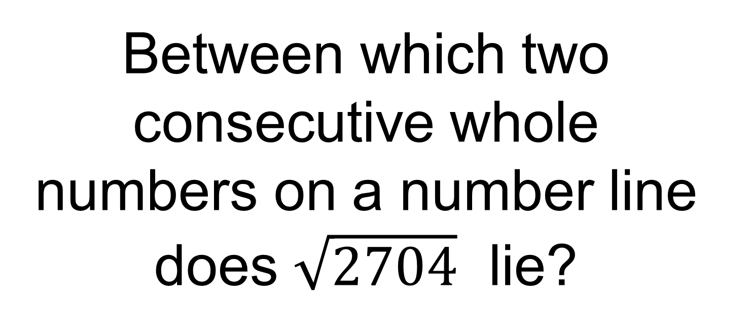
3-2
Between which two consecutive whole numbers on a number line does $\sqrt{2704}$ lie?

Slide 49
3-2 Answer
51 and 53

Slide 50
3-3
If the length of a rectangular television screen is 20
inches and its height is 15 inches, what is the length
of its diagonal, in inches?

Slide 52
3-3 Answer
25 inches

Slide 53
3-4
How many ways can 5 shirts be chosen from 15 shirts to take on a trip?

Slide 55
3-4 Answer
3003

Slide 56
3-5
Find the nth term of 1, 4, 9, 16, 25...

Slide 58
3-5 Answer
81

Slide 59
Extra 3
What number is 63% of 220?

Slide 61
Extra 3 Answer
138.6

Slide 62
4th Cipherer

Slide 63
4-1
Solve the equation
$$\left(2^{3}−2∙8\right)+\left(6−3^{2}\right)=b$$

Slide 65
4-1 Answer
-11=b

Slide 66
4-2
One coin is randomly selected from a jar containing 20 pennies,
15 nickels, 3 dimes, and 12 quarters. Find the odds of each
outcome. Write in simplest form.

Slide 68
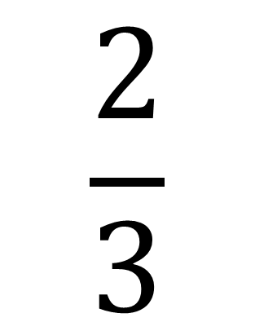
4-2 Answer
$$\frac{2}{3}$$

Slide 69
4-3
Find 3 consecutive integers with the sum of 51.

Slide 71
4-3 Answer
16, 17, and 18

Slide 72
4-4
What is the difference in the value of 2.4(x + 4.2) when x = 5 and x = 4?

Slide 74
4-4 Answer
2.4

Slide 75
4-5
A machine can fill 24 boxes in one hour. At this rate, how many boxes can it fill in five minutes?

Slide 77
4-5 Answer
2 boxes

Slide 78
Extra 4
Javier receives an employee discount of 20%. If he buys a $546 item at the store, what is his discount to the nearest dollar?

Slide 80
Extra 4 Answer
$109

