Slide 1
7th Grade Ciphering

Slide 2
Sample
Solve for x:
7x + 3 = -11

Slide 4
Sample Answer
-2

Slide 6
1-1
Simplify.
y + 12 – 16 • 6(14y + 1)

Slide 8
1-1 Answer
-1343y – 84

Slide 9
1-2
Manuel rode his bike for 15 miles. The trip took him 2 hours. Find Manuel’s rate of speed.

Slide 11
1-2 Answer
7.5

Slide 12
1-3

Slide 14
1-3 Answer
0

Slide 15
1-4
The perimeter of a triangle is 4x + 3y. The legs of the triangle are 5x – 3y and x + 4y. Find the third side of the triangle.

Slide 17
1-4 Answer
- 2x + 2y

Slide 18
1-5
Simplify the expression:
7(3a – 2b) + 5b – 3(4a + 2)

Slide 20
1-5 Answer
9a – 9b – 6

Slide 21
Extra 1
Twenty more than half a number is at least 45. Find the least number that meets this condition.

Slide 23
Extra Answer
50

Slide 25
2-1
Find the median of the following numbers:
88, 79, 94, 90, 45, 71, 82, and 88

Slide 27
2-1 Answer
85

Slide 28
2-2
Evaluate the expression
a²(3b + 5) ÷ c
if a = 2, b = 6 and c = 4

Slide 30
2-2 Answer
23

Slide 31
2-3
A homeowner whose house is assessed for $120,000 pays $1,800 in taxes. At the same rate, what is the tax on a house assessed at $135,000?

Slide 33
2-3 Answer
$2,025

Slide 34
2-4
Caitlyn has practiced playing the piano 5 out of the last 8 days. What percent is this?

Slide 36
2-4 Answer
62.5%

Slide 37
2-5
Write an equation in slope-intercept form for the line that passes through the points (-1,9) and (2,-6).

Slide 39
2-5 Answer
y = -5x + 4

Slide 40
Extra 2
Write the decimal as a mixed number in simplest form.
3.1650

Slide 42
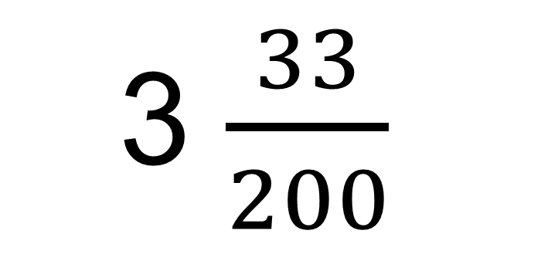
Extra 2 Answer

Slide 43
3rd Cipherer

Slide 44
3-1
Evaluate
6³ + 5⁰ + (-4) + 3!

Slide 46
3-1 Answer
219

Slide 47
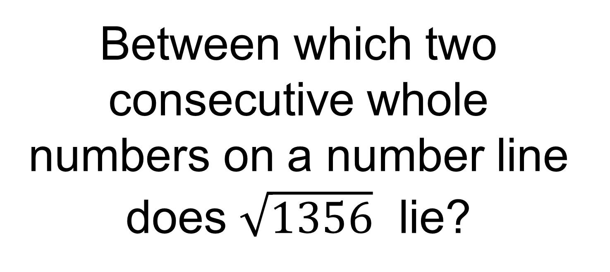
3-2

Slide 49
3-2 Answer
36 and 37

Slide 50
3-3
A 12-foot ladder is leaning against a house. The base of the ladder is 5 feet from the house. How many feet does the ladder reach on the side of the house?

Slide 52
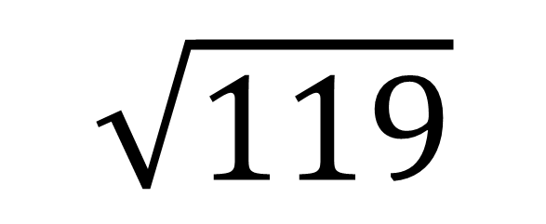
3-3 Answer
$$\sqrt{119}$$

Slide 53
3-4
How many ways can 4 shirts be chosen from 10 shirts to take on a trip?

Slide 55
3-4 Answer
210

Slide 56
3-5
Simplify
3n²(n – 4) + 6n(3n² + n – 7) – 4(n – 7)

Slide 58
3-5 Answer
21n³ - 6n² - 46n + 28

Slide 59
Extra 3
What number is 43% of 110?

Slide 61
Extra 3 Answer
47.3

Slide 62
4th Cipherer

Slide 63
4-1
Solve the equation
(3³ - 3 •9) + (7 – 2²)b = 24b

Slide 65
4-1 Answer
b = 0

Slide 66
4-2
One pencil is randomly selected from a case containing 3 red, 4 green, 2 black, and 6 blue pencils. Find the reciprocal of the P(red or blue).

Slide 68
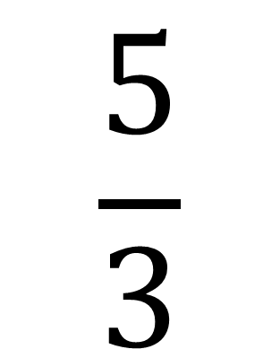
4-2 Answer

Slide 69
4-3
Find three consecutive odd integers with a sum of 63.

Slide 71
4-3 Answer
19, 21, and 23

Slide 72
4-4
What is the difference in the value of 2.1(x + 3.2) when x = 5 and x = 3?

Slide 74
4-4 Answer
4.2

Slide 75
4-5
Tommy is filling his 6000 gallon pool at a constant rate. After 4 hours, the pool contained 800 gallons. How many total hours will it take to completely fill the pool?

Slide 77
4-5 Answer
30 hours

Slide 78
Extra 4
Zach receives an employee discount of 13%. If he buys a $237 item at the store, what is his discount to the nearest dollar?

Slide 80
Extra 4 Answer
$31

