Slide 1
6th Grade Ciphering

Slide 2
Sample
4 + 2 – 8 ÷ 4

Slide 4
Sample Answer
4

Slide 6
1-1
$$60 \% of what number is 12?$$

Slide 8
1-1 Answer
20

Slide 9
1-2
Find the sum of the single digit prime numbers.

Slide 11
1-2 Answer
17

Slide 12
1-3
A jar contains six marbles: one red, one yellow, one orange, one green, one blue, and one purple. If one marble is drawn from the jar at random, what is the probability that it is yellow, green, or purple? Express your answer as a percent.

Slide 14
1-3 Answer
50 %

Slide 15
1-4
What is $\frac{8}{32}$written as a decimal?

Slide 17
1-4 Answer
0.25

Slide 18
1-5
How many different ways can the letters in the word MATH be arranged?

Slide 20
1-5 Answer
$$24$$

Slide 21

Extra 1
Solve for x:
$$\frac{2}{3}+x =\frac{8}{9}$$

Slide 23
Extra Answer
$$\frac{2}{9}$$

Slide 25
2-1
Wes saves a quarter a day. How many dollars can he save in 8 weeks?

Slide 27
2-1 Answer
$14

Slide 28
2-2
In a class of 30 students, 12 are girls. What is the ratio of boys to the total number of students in the class? Express as a fraction in simplest form.

Slide 30
2-2 Answer
$$\frac{3}{5}$$

Slide 31
2-3
24 ÷ 0.008 = Express your answer as a decimal.

Slide 33
2-3 Answer
3000

Slide 34
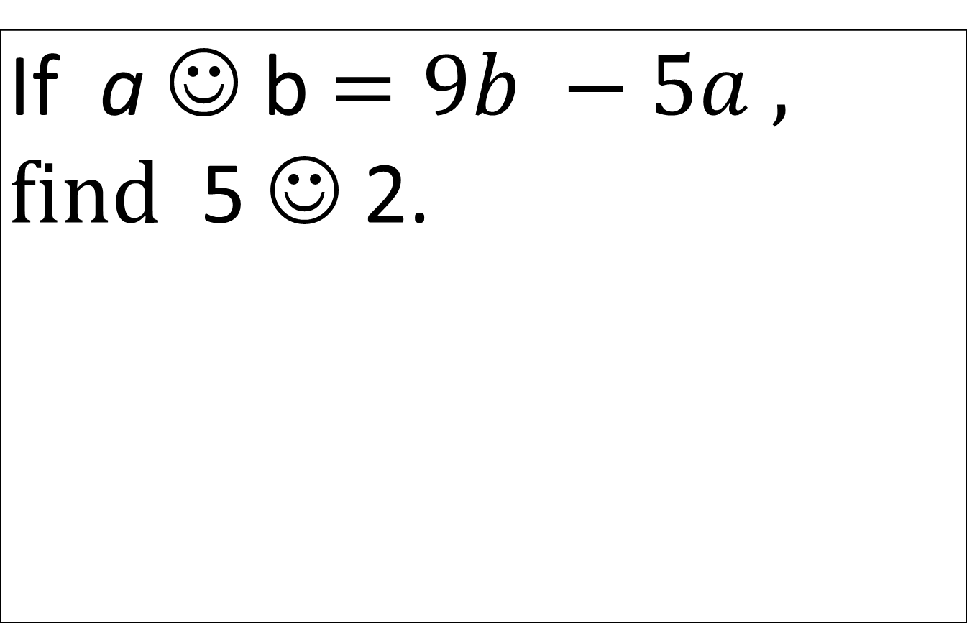
2-4
If a ☺ b $=9b −5a ,$ $find$ 5 ☺ 2.

Slide 36
2-4 Answer
-7

Slide 37
2-5
What is the next number in the sequence ? 1, 2, 5, 6, 9, ____

Slide 39
2-5 Answer
10

Slide 40
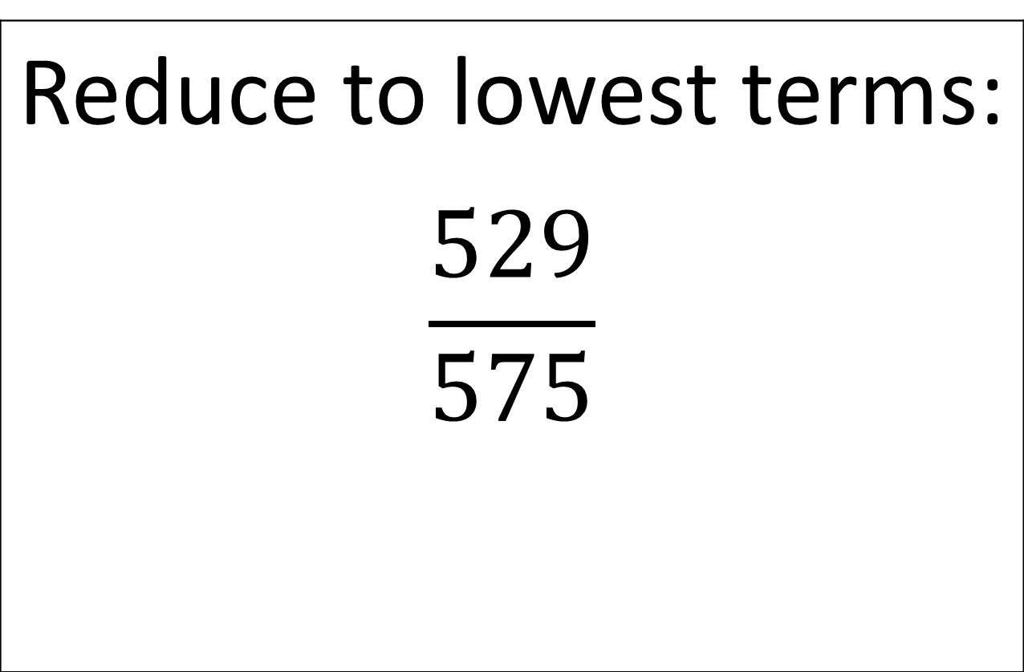
Extra 2
Reduce to lowest terms: $$\frac{529}{575}$$

Slide 42
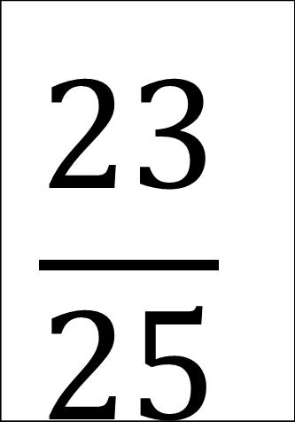
Extra 2 Answer
$$\frac{23}{25}$$

Slide 43
3rd Cipherer

Slide 44
3-1
13y + 9 = 100 Solve for y.

Slide 46
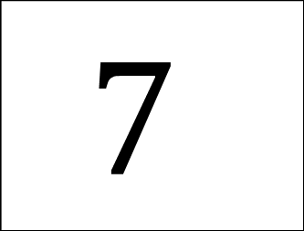
3-1 Answer
$$7$$

Slide 47
3-2
$\frac{1}{2}$ + $\frac{3}{15}$ + $\frac{4}{5}$ + $\frac{3}{20}$ Express your answer as a fraction in simplest form.

Slide 49
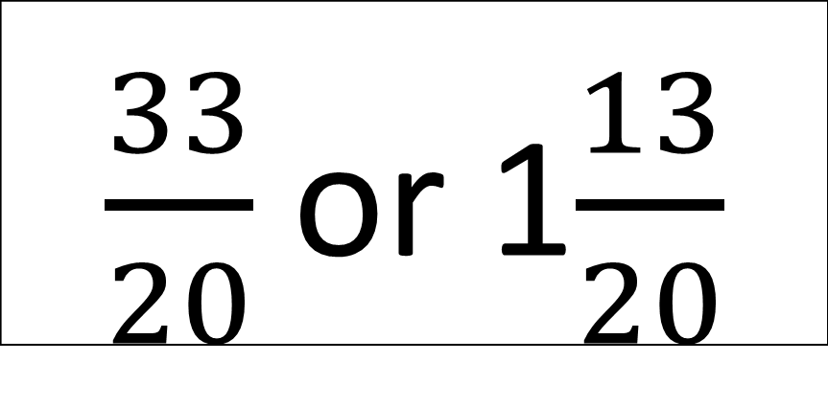
3-2 Answer
$\frac{33}{20}$ or 1$\frac{13}{20}$

Slide 50
3-3
A rectangle’s length is 14cm and its perimeter is 46 cm. What is its area?

Slide 52
3-3 Answer
$$126 or 126 cm²$$

Slide 53
3-4
75% of 240 shoppers were out of money. How many people still had money?

Slide 55
3-4 Answer
60

Slide 56
3-5
Evaluate. Write your answer as a fraction in simplest form. $$\frac{9!8!}{6!7!}$$

Slide 58
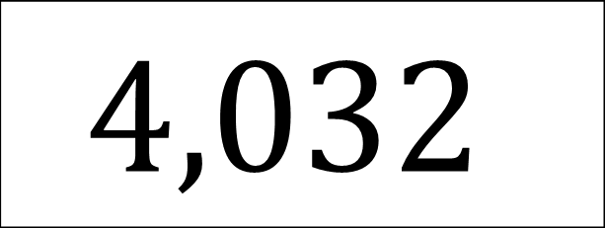
3-5 Answer
$$4,032$$

Slide 59
Extra 3
Find the GCF of 75,93, and 333.

Slide 61
Extra 3 Answer
3

Slide 62
4th Cipherer

Slide 63
4-1
If one survivor eats 15 bugs in 3 minutes, how many bugs can the survivor eat in one hour?

Slide 65
4-1 Answer
300

Slide 66
4-2
Find the average of the first 5 prime numbers. Express your answer as a decimal.

Slide 68
4-2 Answer
5.6

Slide 69
4-3
Will, Bill, and Jill were running for president. Out of the 250 people who voted, 60% voted for Jill. How many people voted for Jill?

Slide 71
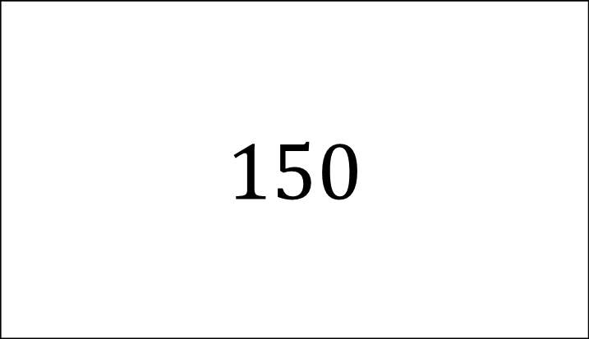
4-3 Answer
$$150$$

Slide 72
4-4
At Ben’s Burger Palace, 45% of the customers order large soft drinks. What fraction of the customers order large soft drinks?

Slide 74
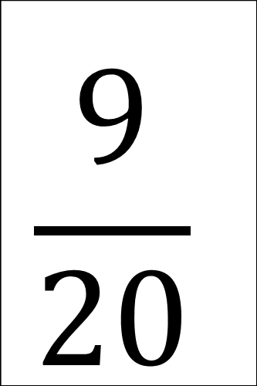
4-4 Answer
$$\frac{9}{20}$$

Slide 75
4-5
Evalute. Express your answer as a fraction in lowest term. $$\frac{11}{51}÷\frac{11}{17}$$

Slide 77
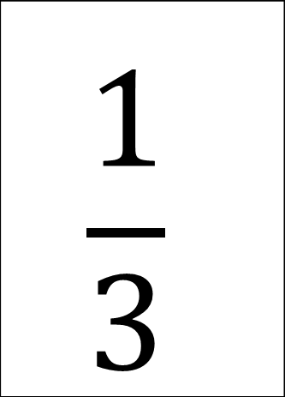
4-5 Answer
$$\frac{1}{3}$$

Slide 78
Extra 4
What is the probability of choosing an even number from 1 to 30? Express your answer as a percent.

Slide 80
Extra 4 Answer
50%

