Slide 1
6th Grade Ciphering

Slide 2
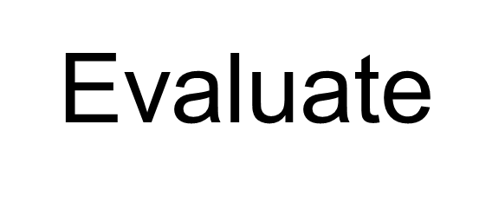
Sample

Slide 4
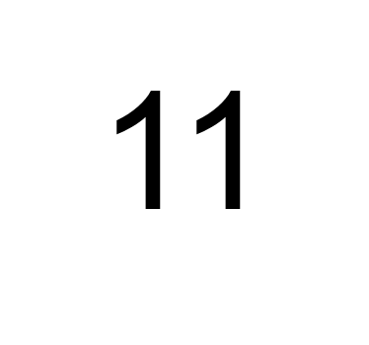
Sample Answer

Slide 6
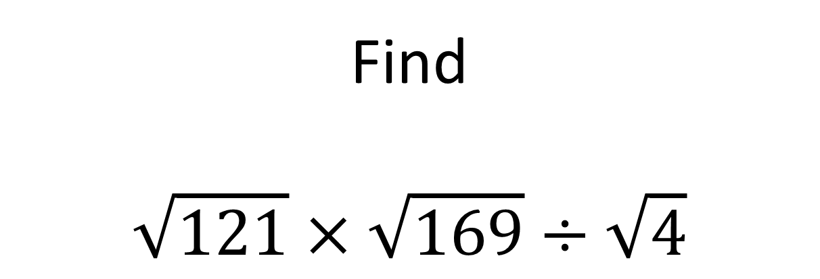
1-1
Find
$$\sqrt{121}×\sqrt{169}÷\sqrt{4}$$
Express your answer as a decimal.

Slide 8
1-1 Answer
71.5

Slide 9
1-2
If x ☺ y $=8x +9y ,$
$find$5 ☺ 5.

Slide 11
1-2 Answer
85

Slide 12
1-3
Summer and Judd paid $30 to go to the movies. If the tickets were $8.50 each, how much did they spend on popcorn and drinks?

Slide 14
1-3 Answer
$13

Slide 15

1-4
Evaluate:
$$3∙6∙5+3−0×0∙1$$

Slide 17
1-4 Answer
90

Slide 18
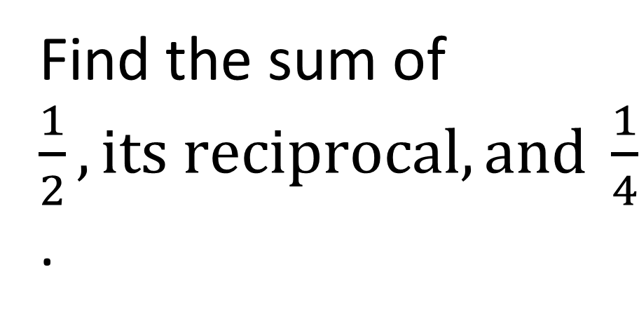
1-5
Find the sum of $\frac{1}{2}, its reciprocal, and \frac{1}{4}$.

Slide 20
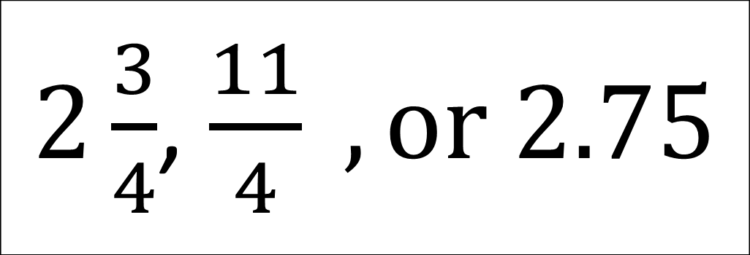
1-5 Answer
$2\frac{3}{4}$, $\frac{11}{4} , or 2.75$

Slide 21

Extra 1
Solve for x:
$$\frac{2}{3}+x =\frac{8}{9}$$

Slide 23
Extra Answer
$$\frac{2}{9}$$

Slide 25
2-1
8 Fuzzles are equal to 1 Wuzzle and 4 Wuzzles are equal to 2 Zazzles. How many Fuzzles make up 16 Wuzzles and 8 Zazzles?

Slide 27
2-1 Answer
256

Slide 28
2-2
The perimeter of a rectangle is 64 cm. If the length is 20, what is the width?

Slide 30
2-2 Answer
12 or 12cm

Slide 31
2-3
If 5.08cm = 1 inch, find the number of cm in a dozen inches. Express your answer as a decimal.

Slide 33
2-3 Answer
60.96 or 60.96cm

Slide 34
2-4
Evaluate and express your answer as a mixed number in simplest form: $$\frac{1}{3}+\frac{5}{7}+\frac{1}{9}$$

Slide 36
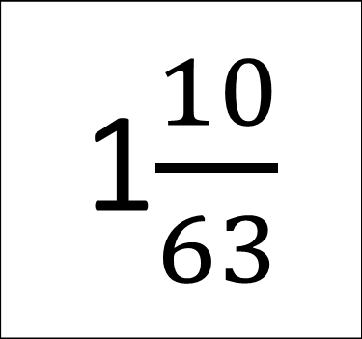
2-4 Answer
1$\frac{10}{63}$

Slide 37
2-5
Rachel, Kristi, and Carmen lose their marbles. Tommy has 24 marbles. How many marbles will Tommy have to give away for them ALL to have the same number of marbles?

Slide 39
2-5 Answer
18

Slide 40
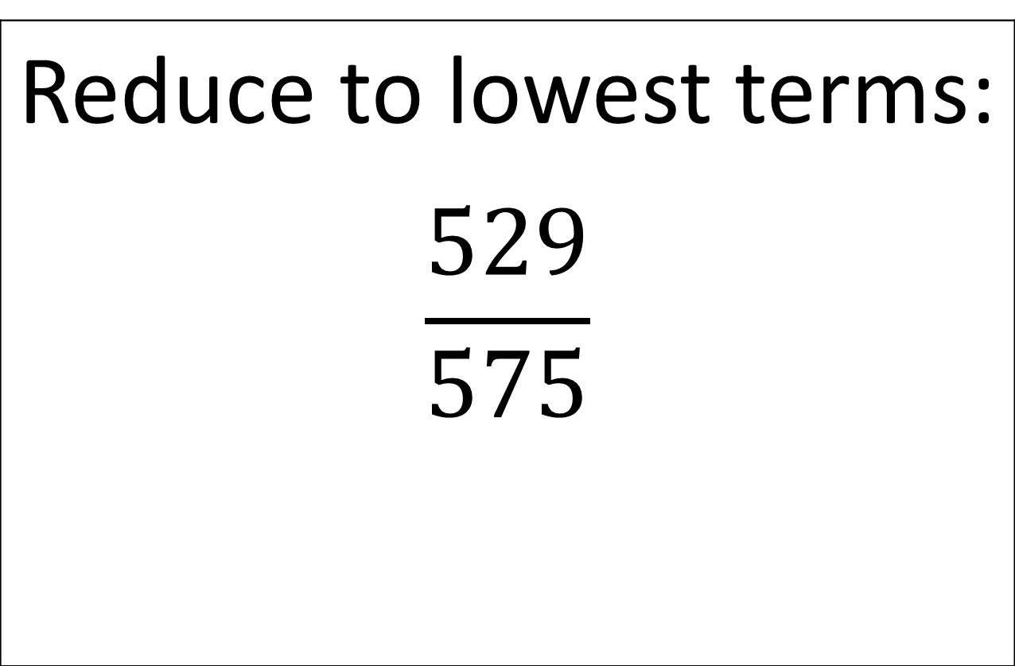
Extra 2
Reduce to lowest terms: $$\frac{529}{575}$$

Slide 42
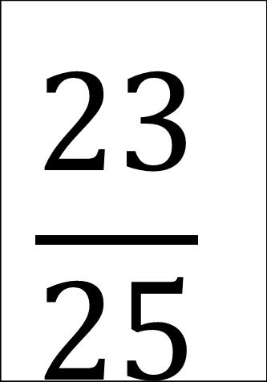
Extra 2 Answer
$$\frac{23}{25}$$

Slide 43
3rd Cipherer

Slide 44
3-1
If a triangle has one angle that is 72 degrees and one angle that is 53 degrees, what is the third angle?

Slide 46
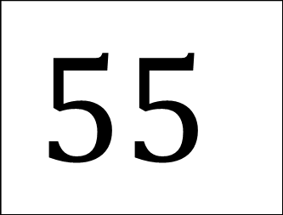
3-1 Answer
$$55$$

Slide 47
3-2
What is the greatest common factor of 676 and 52?

Slide 49
3-2 Answer
52

Slide 50
3-3
What is the next term in the pattern? 2, $\frac{1}{2},$4, $\frac{1}{4}, 8, \frac{1}{8}, _____$

Slide 52
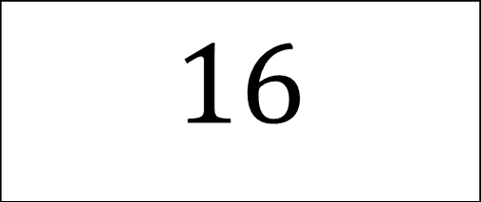
3-3 Answer
$$16$$

Slide 53
3-4
How many prime numbers are between 50 and 100?

Slide 55
3-4 Answer
10

Slide 56
3-5
Evaluate. Write your answer as a fraction in simplest form. $$\frac{10!8!}{6!12!}$$

Slide 58
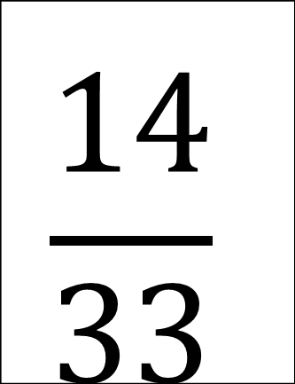
3-5 Answer
$$\frac{14}{33}$$

Slide 59
Extra 3
Find the GCF of 75,93, and 333.

Slide 61
Extra 3 Answer
3

Slide 62
4th Cipherer

Slide 63
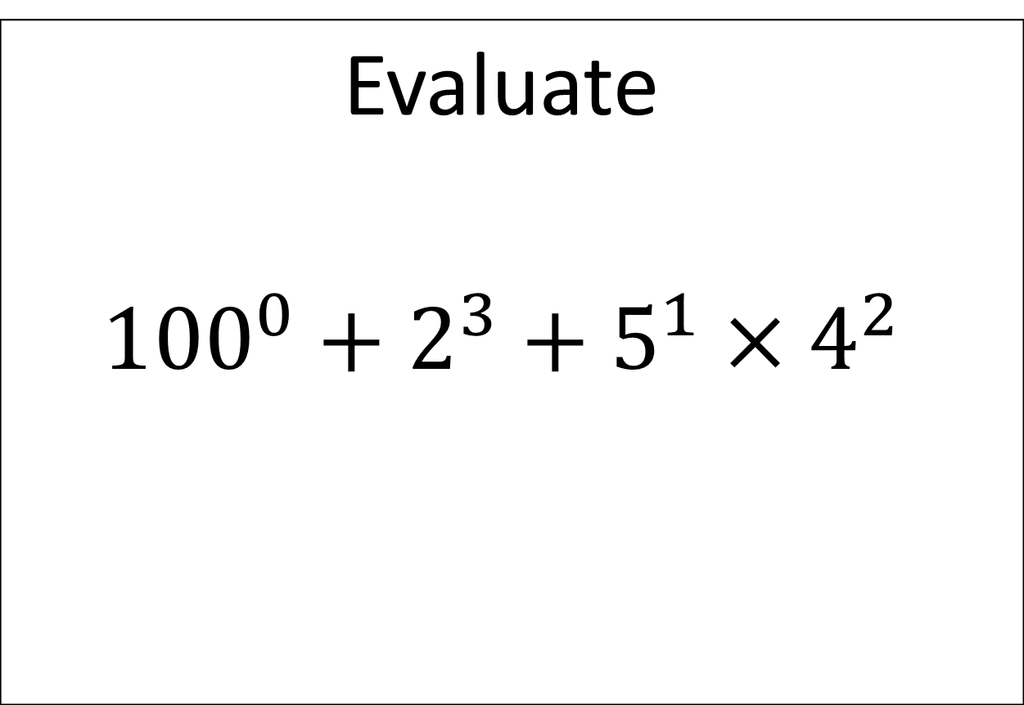
4-1
Evaluate $${100}^{0}+2^{3}+5^{1}×4^{2}$$

Slide 65
4-1 Answer
89

Slide 66
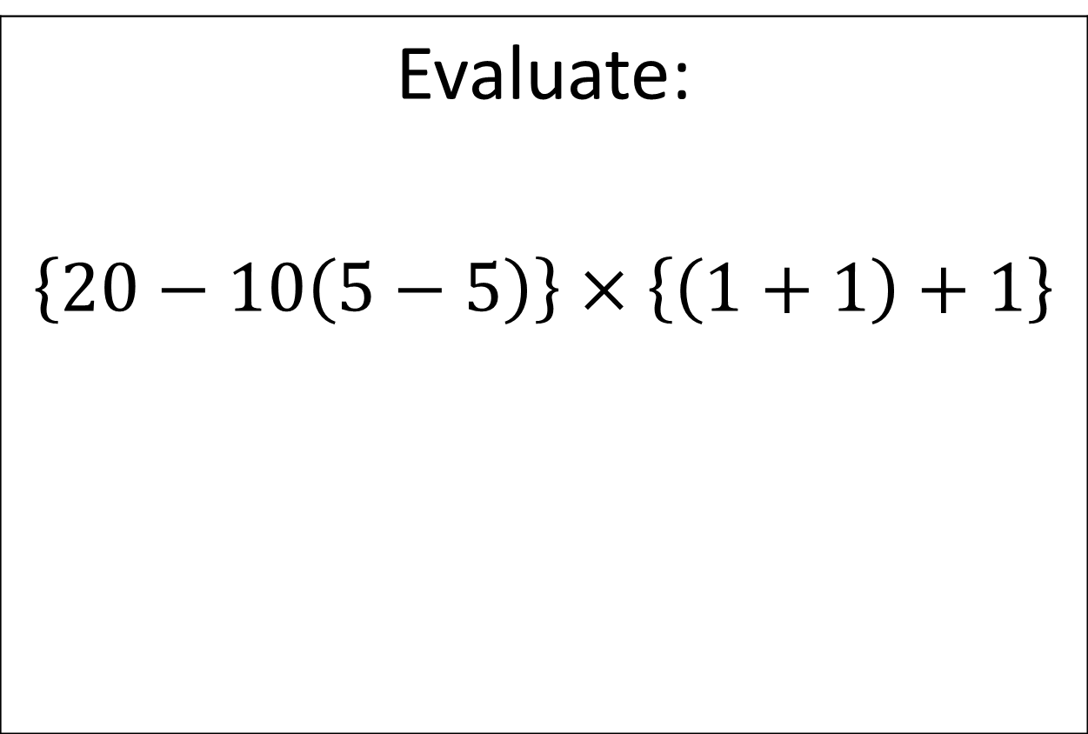
4-2
Evaluate: $\left\{20−10\left(5−5\right)\right\}$ $×\left\{\left(1+1\right)+1\right\}$

Slide 68
4-2 Answer
60

Slide 69
4-3
Express $\frac{3}{8}$ as a percent.

Slide 71
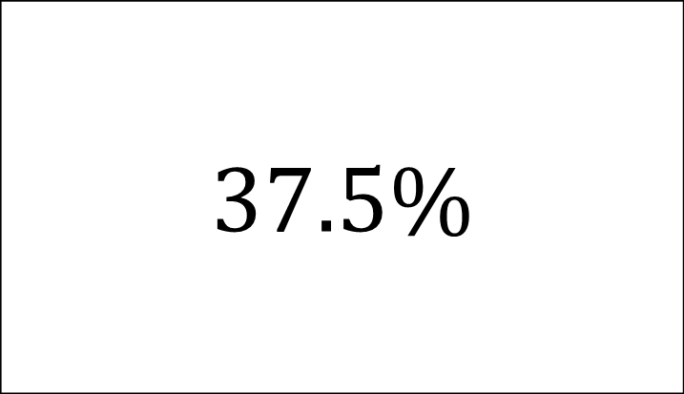
4-3 Answer
$$37.5\%$$

Slide 72
4-4
Find the mean of the 10th, 11th, and 12th, 13th term in the sequence: 500, 460, 420, 380, …

Slide 74
4-4 Answer
80

Slide 75
4-5
Evalute. Express your answer as a fraction in lowest term. $$\frac{22}{105}÷\frac{11}{5}$$

Slide 77
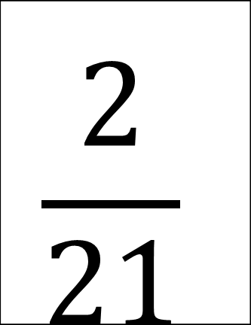
4-5 Answer
$$\frac{2}{21}$$

Slide 78
Extra 4
What is the probability of choosing an even number from 1 to 30? Express your answer as a percent.

Slide 80
Extra 4 Answer
50%

